Slide 1
NFA to DFA

Slide 2
ɛ-NFA to DFA

Slide 3
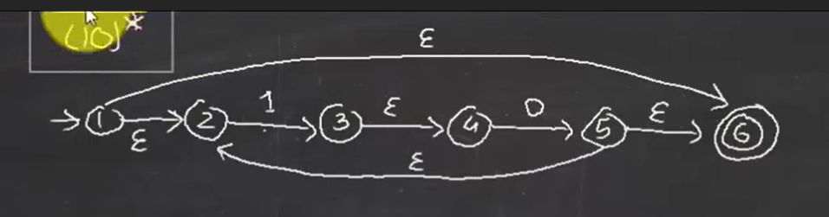
ɛ-closure{1} | {1, 2, 6} | As {1} is the start state
To get the DFA of corresponding NFA
states | 1 | 0
{1, 2, 6} | ɛ-closure{3}={3,4} | ɛ-closure{ø}=ø
{3,4} | ɛ-closure{ø}=ø | ɛ-closure{5}={5,6,2}={2,5,6}
{2,5,6} | ɛ-closure{3}={3,4} | ɛ-closure{ø}=ø
Ø | Ø | Ø

Slide 4
To get the DFA of corresponding NFA
states | 1 | 0
{1,2,6} | ɛ-closure{3} ≡ {3,4} | ɛ-closure{ø} ≡ ø
{3,4} | ɛ-closure{ø} ≡ ø | ɛ-closure{5} ≡ {2,5,6}
{2,5,6} | ɛ-closure{3} ≡ {3,4} | ɛ-closure{ø} ≡ ø
Ø | Ø | ø
 | This is our auxiliary table
 | states | 1 | 0
A | {1,2,6} | {3,4} | ø
B | {3,4} | ø | {2,5,6}
C | {2,5,6} | {3,4} | ø
A
1
B
Transition table to convert NFA into DFA
states | 1 | 0
A | B | Ø
B | Ø | C
C | B | Ø
Ø | Ø | ø
0
1
0
C
0
Ø
1,0
1

Slide 5
